Slide 1



NN-based reduced order modeling of PDEs
NN-based reduced order modeling of PDEs
Andrea Boselli Carlo Ghiglione Leonardo Perelli

Slide 2
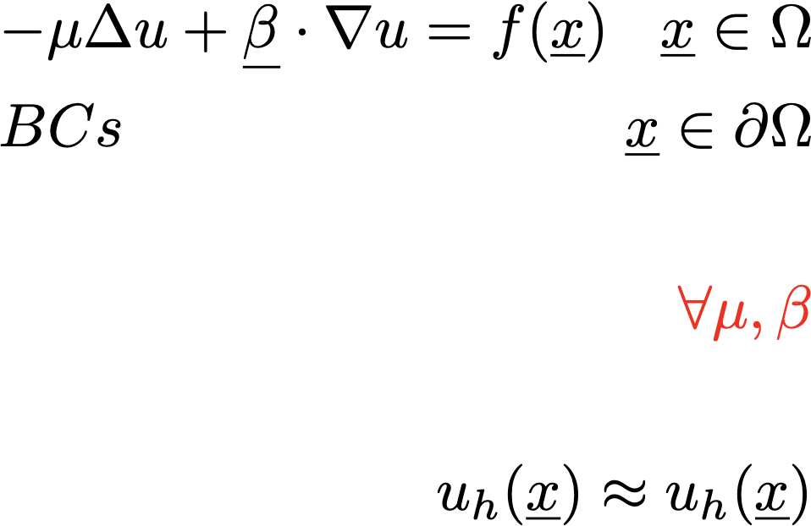
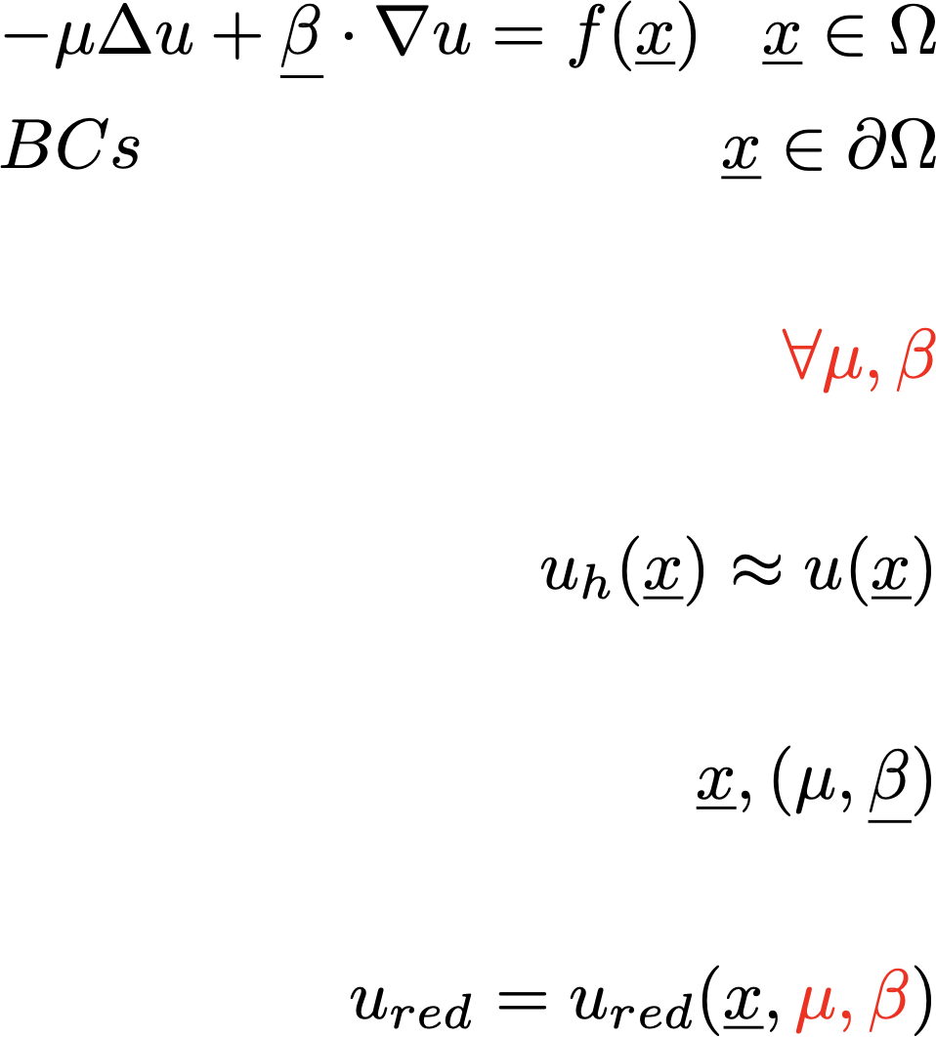
From a Classical Approach…
Model:
Numerical Method Solution:
Pros: High accuracy
Cons: Time duration
Computational resources
Very expensive to solve for many sets of parameters!

Slide 3
… to Reduced Order Modeling
High Fidelity Model
Reduced-order Model
Long training time
Model design
Fast execution
Reusable

Slide 4
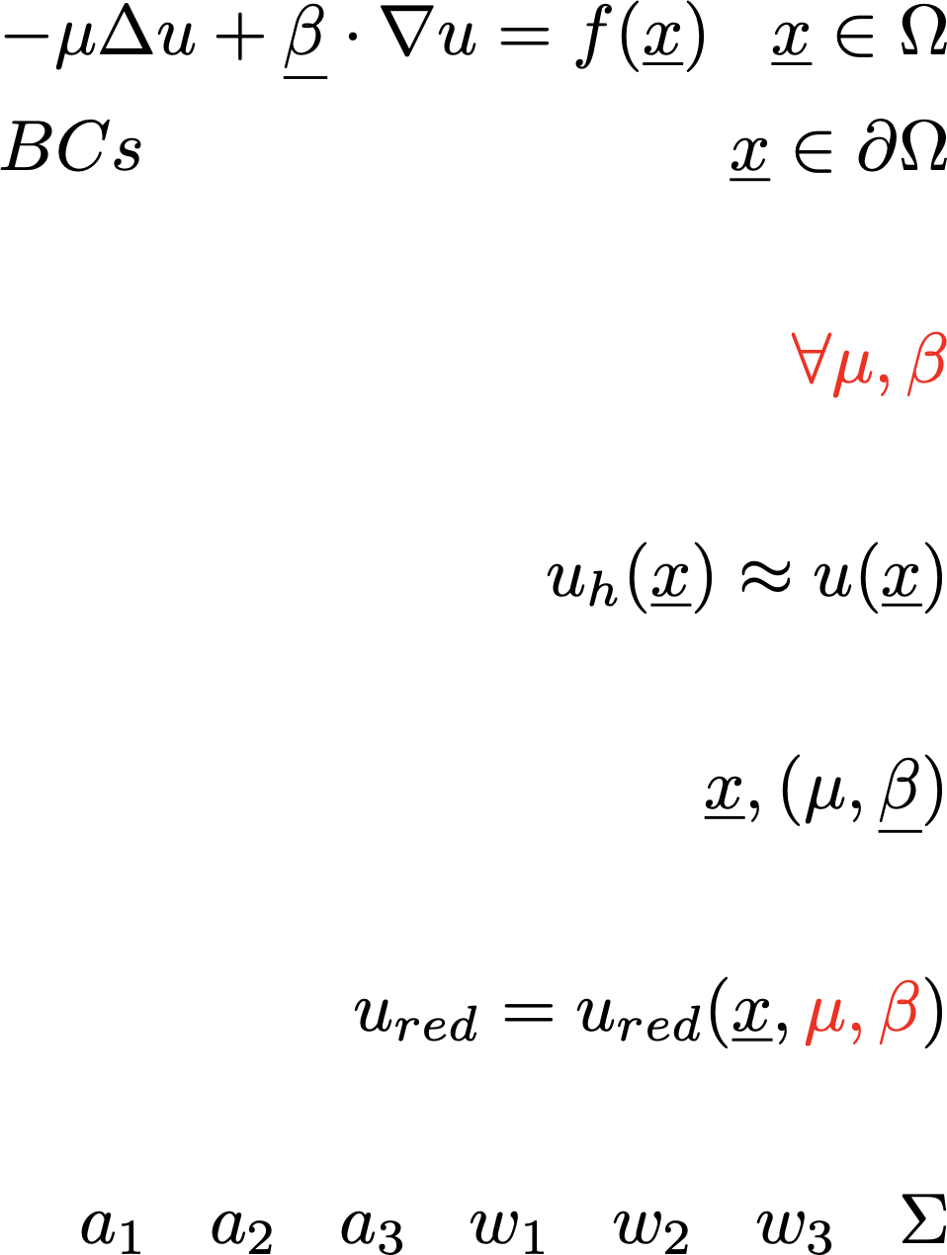
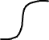
Neurons
Inputs:
Weights:
Activation function:
Output:

Slide 5
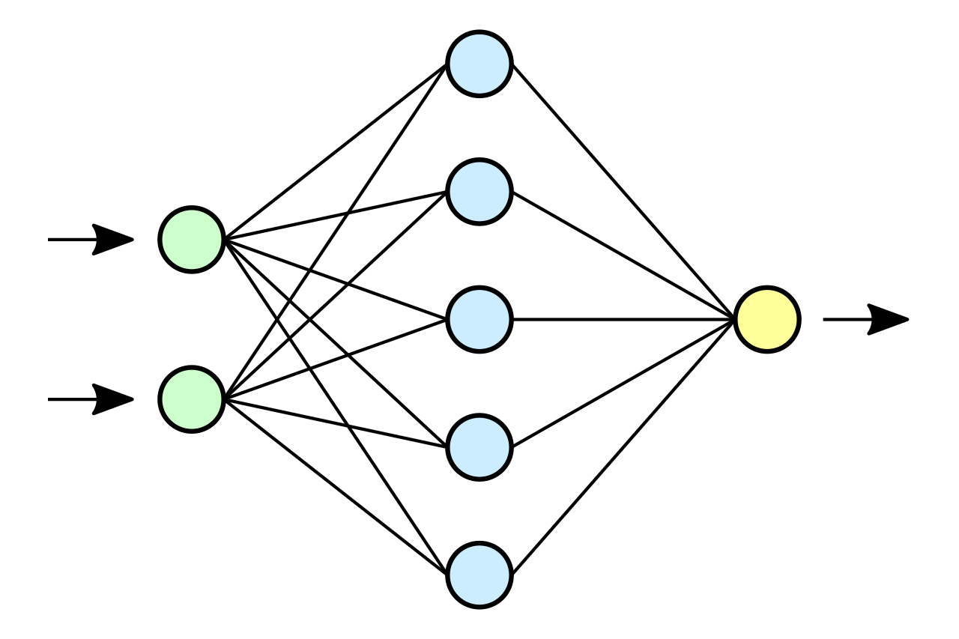
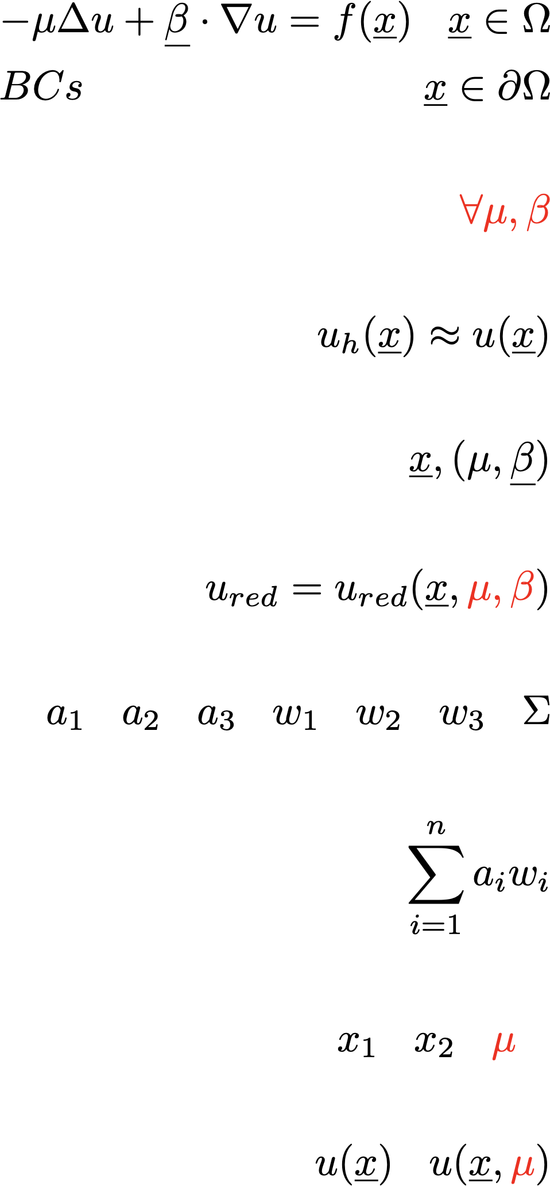
Neural Networks
Stack of layers of neurons
Very complex and nested functions
Can approximate any function (Universal Approximation Theorem, Hornik,1991)
Weights determine the output of the network
How to find the best weights?

Slide 6
Loss Minimization
The loss measures the distance between the output of the neural network function and the target function
Quality of the NN approximation
Loss
Minimize
:
Gradient descent:

Slide 7
NNs meet PDEs
How to use Neural Networks as Reduced Order Models?
Include PDE’s parameters in the input of NN
How to include knowdedge of the physics?
PINNs!

Slide 8
PINNs
To enforce the physics of the problem, we introduce in the loss function the residual of the Neural Network solution with respect to the PDE
: Approximation error
: PDE residual of Neural Network solution
: BC residual of Neural Network solution

Slide 9
Goals
Does the PDE loss term help?
How much should the different loss terms be weighted?
How accurate are the solutions?

